Slide 1
Stream Estimation 1: Count-Min Sketch

Slide 2
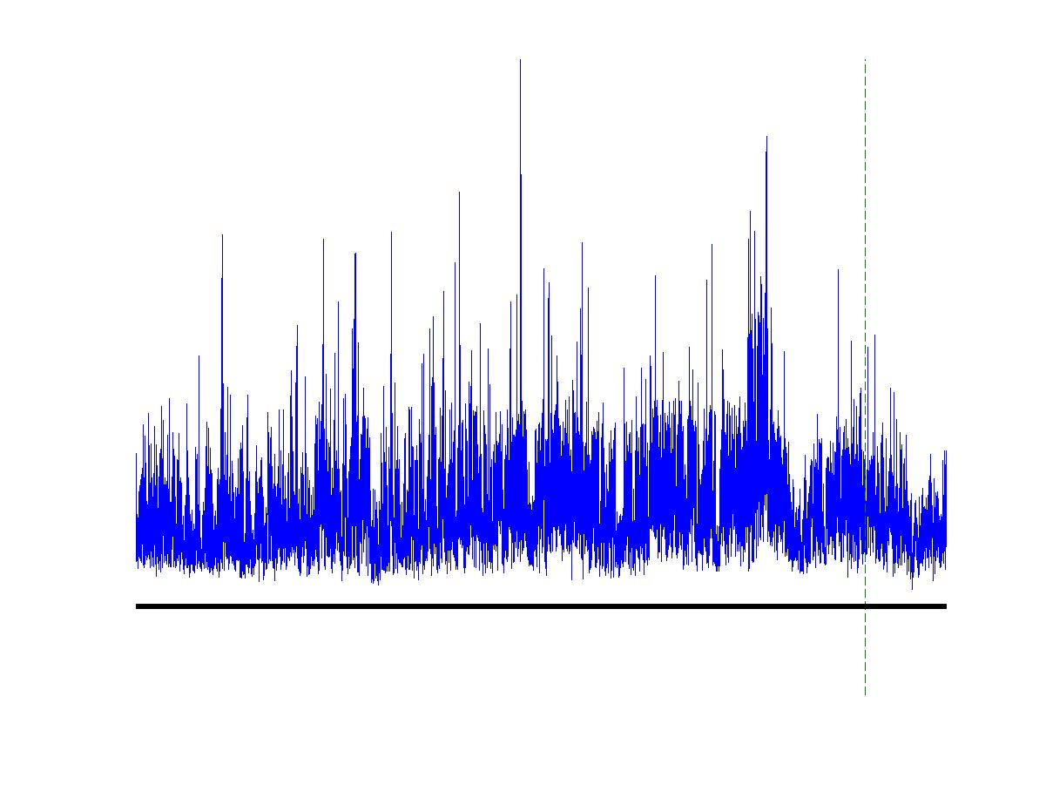
Contd..
Input data element enter one after another (i.e., in a stream).
Cannot store the entire stream accessibly
How do you make critical calculations about the stream using a limited amount of memory?

Slide 3
Applications
Mining query streams
Google wants to know what queries are more frequent today than yesterday
Mining click streams
Yahoo wants to know which of its pages are getting an unusual number of hits in the past hour
Mining social network news feeds
E.g., look for trending topics on Twitter, Facebook

Slide 4
Applications
Sensor Networks
Many sensors feeding into a central controller
Telephone call records
Data feeds into customer bills as well as settlements between telephone companies
IP packets monitored at a switch
Gather information for optimal routing
Detect denial-of-service attacks

Slide 5
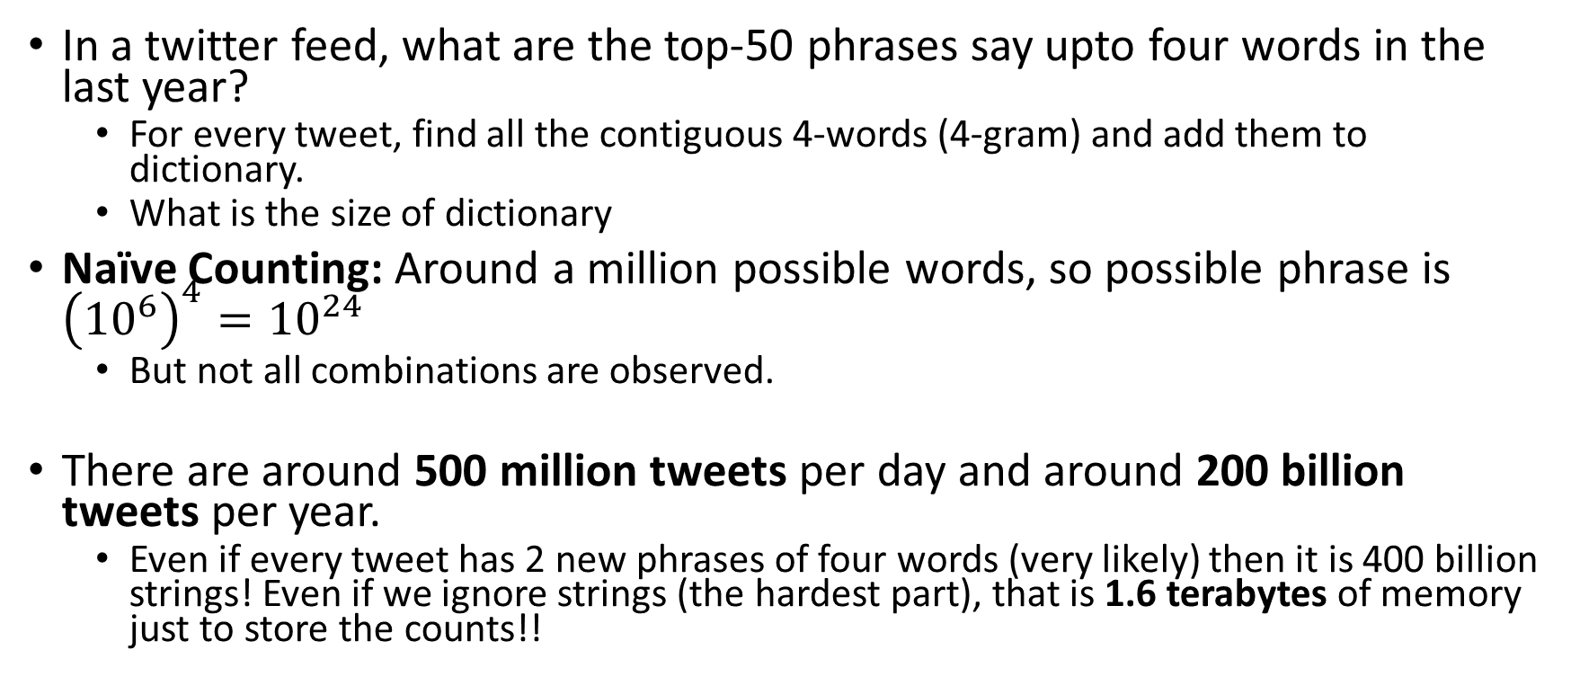
A Simple Problem (Heavy Hitters Problem)
In a twitter feed, what are the top-50 phrases say upto four words in the last year?
For every tweet, find all the contiguous 4-words (4-gram) and add them to dictionary.
What is the size of dictionary
Naïve Counting: Around a million possible words, so possible phrase is ${\left({10}^{6}\right)}^{4}={10}^{24}$
But not all combinations are observed.
There are around 500 million tweets per day and around 200 billion tweets per year.
Even if every tweet has 2 new phrases of four words (very likely) then it is 400 billion strings! Even if we ignore strings (the hardest part), that is 1.6 terabytes of memory just to store the counts!!

Slide 6
More Heavy Hitter Problem
Computing popular products and context: For example, we want to know popular page views of products on amazon.com given a variety of constraints.
Identifying heavy TCP flows. A list of data packets passing through a network switch, each annotated with a source-destination pair of IP addresses and some context. The heavy hitters are then the flows that are sending the most traffic. This is useful for, among other things, identifying denial-of-service attacks
Stock trends (co-occurrence in sets)

Slide 7
Can we do better?
Not always.
There is no algorithm that solves the Heavy Hitters problems (for all inputs) in one pass while using a sublinear amount of auxiliary space.
Can be proven using pigeonhole principle.

Slide 8
Can we do better? Specific Inputs
Finding the Majority Element:
You’re given as input an array A of length n, with the promise that it has a majority element — a value that is repeated in strictly more than n/2 of the array’s entries. Your task is to find the majority element.
O(n) solution?
Can you do it in one pass and O(1) storage?

Slide 9
The Solution
For i = 0 to n-1{
if i == 0
{ current = A[i];
currentcount = 1;}
else
{
if (current == A[i])
currentcount++
else
{
currentcount - -
if(currentcount == 0)
current = A[i]
}
}
}
Proof?

Slide 10
Hope?
General case. No!
However, if we know that the stream contains element with large counts, then something is possible.

Slide 11
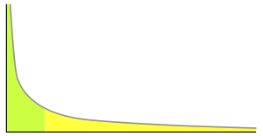
Power Law in Real World
Exactly: No Hopes, we need dictionary O(N).
Approximation : Wont be accurate on General Input
Approximation and Power Law Input: YES!!
Real word data follows power law. Some things are repeated all the time, most things occur rarely.
Browsing History
User Queries
Phrases
Human Patterns

Slide 12



Revise: Bloom Filters
Use K-independent hash functions
Just select seeds independently.
K = 3 illustration
Given a query q, if all $h_{1}\left(q\right), h_{2}\left(q\right), h_{3}\left(q\right)$is set, return seen else no.
False Positive Rate?
$S_{1}$
$S_{2}$
0 | 0 | 1 | 0 | 1 | 0 | 1 | 0 | 0 | 1 | 0 | 1 | 1 | 1 | 0

Slide 13

What can Bloom Filters with Counters do
To simplify, lets just take 1 (K=1) random hash function and use counters instead of bits, so whenever s is occurred, increment h(s).
Given string q, estimate its frequency with the frequency of hashed counter h(q).
Reminder with universal hash function, the probability of Pr(h(s) = c) = $\frac{1}{R}$
h(s)
0 | 0 | 1 | 0 | 17 | 20 | 1 | 0 | 0 | 151 | 2 | 9 | 11 | 71 | 30

Slide 14
Survival of Fittest (natural selection)
The Good
+
The Irrelevant
+
+
The Unlucky

Slide 15
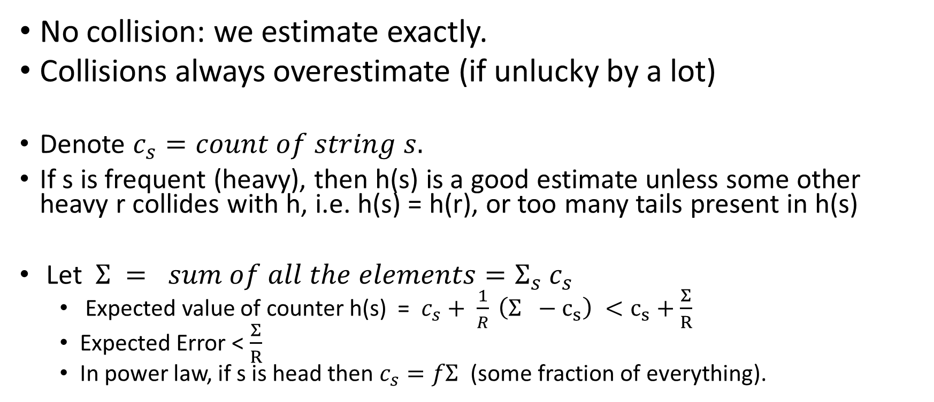
Points to Ponder
No collision: we estimate exactly.
Collisions always overestimate (if unlucky by a lot)
Denote $c_{s}=count of string s.$
If s is frequent (heavy), then h(s) is a good estimate unless some other heavy r collides with h, i.e. h(s) = h(r), or too many tails present in h(s)
Let $Σ = sum of all the elements=Σ_{s} c_{s}$
Expected value of counter h(s) = $c_{s}+ \frac{1}{R} \left(Σ −c_{s}\right) <c_{s}+\frac{Σ}{R}$
Expected Error < $\frac{Σ}{R}$
In power law, if s is head then $c_{s}=fΣ$ (some fraction of everything).

Slide 16
Can we do better?
Repeat Independently d times, take minimum (Count-Min)
Unless all the d counters messes up simultaneously, we have a good estimate.
For heavy hitters, unless every d counters has more than 2 heavy hitters we are fine.

Slide 17

Summary of Algorithm
Take d, independent hash function $h_{1}, .. h_{d}$ and d arrays of size R.
Update: Any string s, increment $h_{i}\left(s\right)$in array i.
Estimate Counts: Given query q, return min ($h_{1}\left(q\right), h_{2}\left(q\right),... h_{d}(q)$)
Update and Estimate cost O(d)

Slide 18
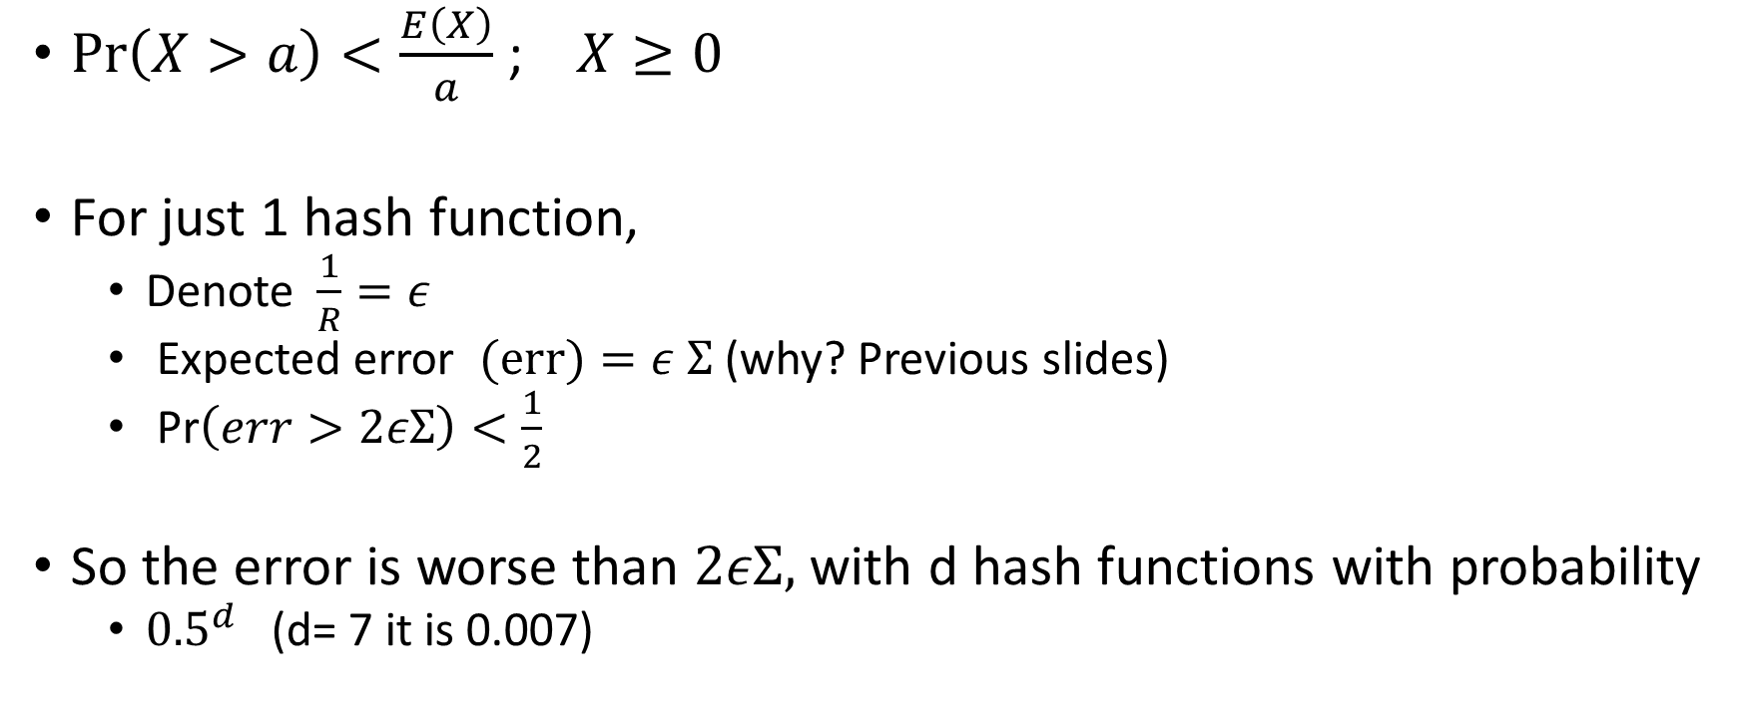
Markov Inequality
$\operatorname{Pr}\left(X>a\right)<\frac{E\left(X\right)}{a}$ ; $X≥0$
For just 1 hash function,
Denote $\frac{1}{R}=ε$
Expected error $(err)=ε Σ$ (why? Previous slides)
Pr$\left(err>2εΣ\right)<\frac{1}{2}$
So the error is worse than $2εΣ,$ with d hash functions with probability
${0.5}^{d}$ (d= 7 it is 0.007)

Slide 19
Mental Exercise
When to increase d (number of hash functions)?
When to increase R (or the range)?

Slide 20
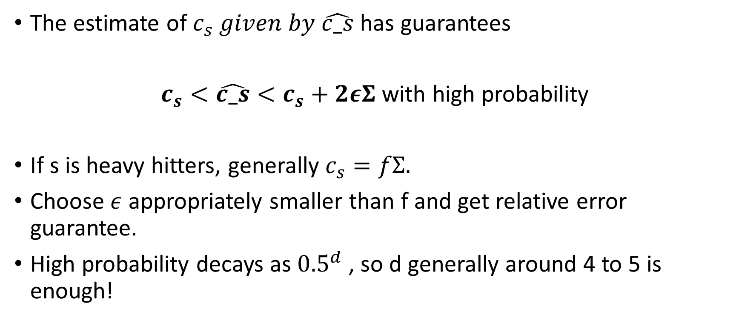
Summary so far !
The estimate of $c_{s} given by \hat{c_s}$ has guarantees
$c_{s}<\hat{c_s}<c_{s}+2εΣ$ with high probability
If s is heavy hitters, generally $c_{s}=fΣ.$
Choose $ε$ appropriately smaller than f and get relative error guarantee.
High probability decays as ${0.5}^{d}$ , so d generally around 4 to 5 is enough!

Slide 21
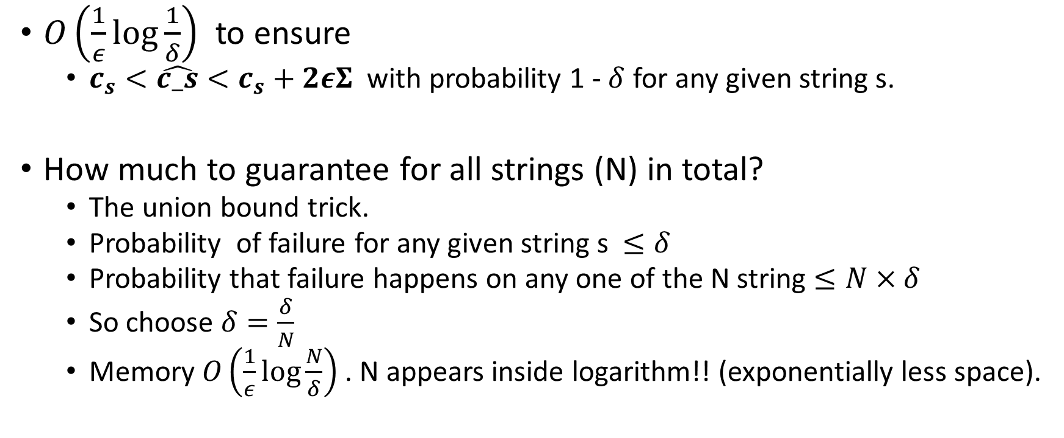
Memory requirements?
$O\left(\frac{1}{ε}\log{\frac{1}{δ}}\right)$ to ensure
$c_{s}<\hat{c_s}<c_{s}+2εΣ$ with probability 1 - $δ$ for any given string s.
How much to guarantee for all strings (N) in total?
The union bound trick.
Probability of failure for any given string s $≤δ$
Probability that failure happens on any one of the N string $≤N×δ$
So choose $δ=\frac{δ}{N}$
Memory $O\left(\frac{1}{ε}\log{\frac{N}{δ}}\right)$. N appears inside logarithm!! (exponentially less space).

Slide 22
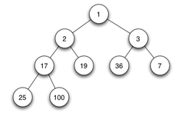
How to identify top-k?
Given s, we can estimate its count quite accurately. How do we solve the identifying top-k problem?
Use heaps
Keep a minheap of size k
Whenever, we see a string s, update, estimate and check if the estimate is less than min of top-k heap, update heap if more. (O(log(k)))
total update cost dlogk in worst case.

Slide 23
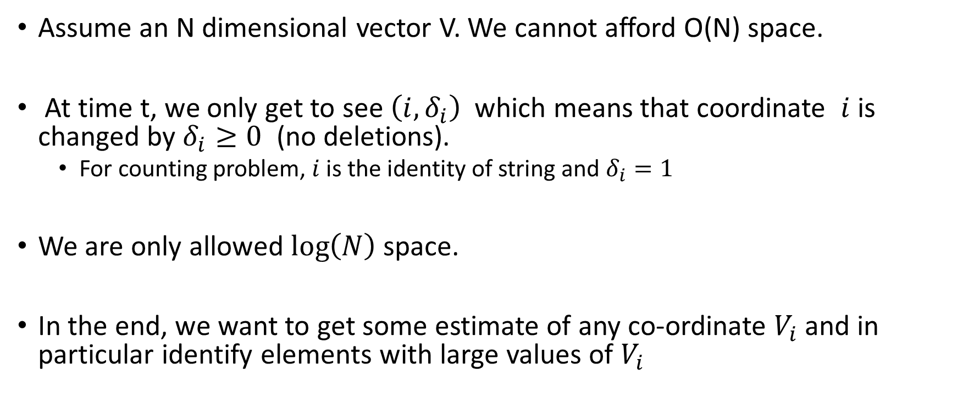
Turnstile Model of Stream
Assume an N dimensional vector V. We cannot afford O(N) space.
At time t, we only get to see $\left(i, δ_{i}\right)$ which means that coordinate $i$is changed by $δ_{i}≥0$ (no deletions).
For counting problem, $i$ is the identity of string and $δ_{i}=1$
We are only allowed $\log\left(N\right)$ space.
In the end, we want to get some estimate of any co-ordinate $V_{i}$ and in particular identify elements with large values of $V_{i}$

Slide 24
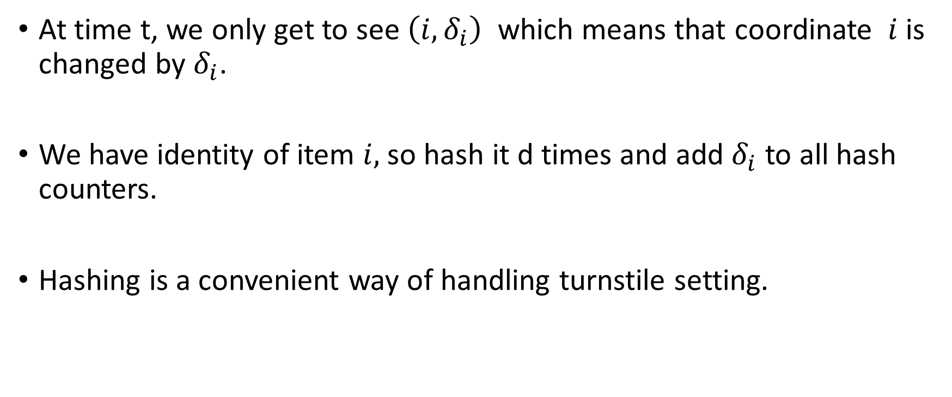
Can we use count-sketch in turnstile setting?
At time t, we only get to see $\left(i, δ_{i}\right)$ which means that coordinate $i$is changed by $δ_{i}$.
We have identity of item $i,$so hash it d times and add $δ_{i}$ to all hash counters.
Hashing is a convenient way of handling turnstile setting.

Slide 25
Some Observation
We saw that for the general problem, there is not much hope in < O(N) memory.
However, with power law input, we can get exponential improvements!
It is about solving problems and not getting stuck in formalism
If you see an impossibility result, that only means that your formalism is not right (generally too harsh) for the problem at hand.

